Slide 1

Project Title
SHAHEED BENAZIR BHUTTO UNIVERSITY, SHAHEED BENAZIRABAD
Knowledge Commitment Leadership
Group Members
Students Name Roll #
Students Name Roll #
Students Name Roll #
Students Name Roll #
Name of Supervisor(s):

Slide 2
Presentation Outline
Introduction
Background and Motivation / Problem Statement
Relevant Work / Literature Review
Aim and Objectives
Methodology
Scope/Application
Timeline
References

Slide 3
Introduction (2 – 3 slides)
You will give the general introduction of the project.

Slide 4
Background and Motivation / Problem Statement(1 – 2 slides)
You will mention here that what motivates you or how you decided to work on the project.

Slide 5
Relevant Work / Literature Review (1 – 2 slides)
Any work or research done related to your topic and how your work is an different to that work. Preferably in the following format
Ref. | Title | Summary | Remarks
[1]
[2]
[3]

Slide 6
Aim and Objectives (1 slide)
Aim
Your aims behind doing this project.
The objectives are following:
Objective 1:
Objective 2:
Objective 3:

Slide 7
Methodology (1 slide)
Methodology is the set of steps you will perform to achieve each objective that you have mention.

Slide 8
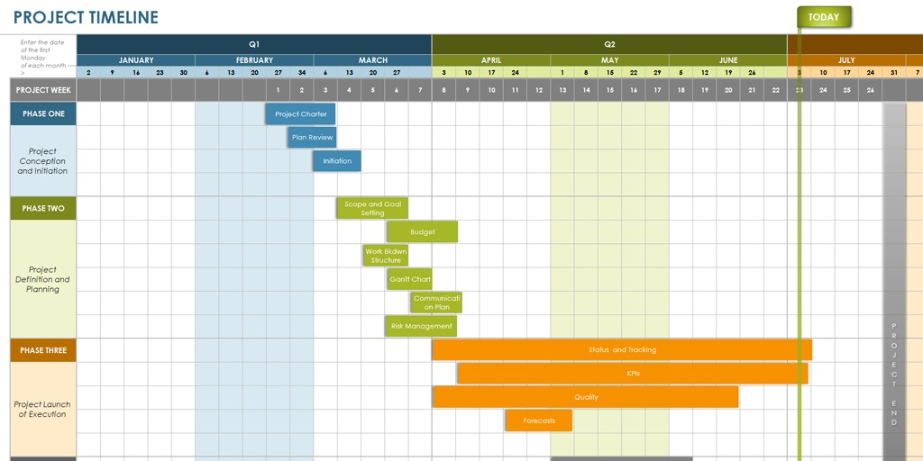
Timeline (1 slide)
How is your work planned according to the time limits starting from the start of the term to the final presentation.
Sample timeline

Slide 9
References (1 – 2 slides)
Here you will mention the references used in your thesis/project.
The style of the references should be APA.
Sample references
[1] Hornbæk, K. (2006). Current practice in measuring usability: Challenges to usability studies and research. International journal of human-computer studies, 64(2), 79-102..
[2] Brooke, J. (1996). SUS: a “quick and dirty'usability. Usability evaluation in industry, 189.

Slide 10
General Guidelines
The maximum number of slides should not be more than 15.
The total time for the presentation is 20 minutes.

